Slide 1
Deep learning incorporating biologically inspired neural dynamics and in-memory computing
Stanisław Woźniak, Angeliki Pantazi, Thomas Bohnstingl and Evangelos Eleftheriou

Slide 2
Abstract
We present an alternative perspective of the spiking neuron that incorporates its neural dynamics into a recurrent ANN unit called a spiking neural unit (SNU). SNUs may operate as SNNs, using a step function activation, or as ANNs, using continuous activations.
We evaluated the performance of SNU-based networks on three tasks: handwritten digit recognition using MNIST dataset, language modelling using Penn Treebank (PTB) dataset and polyphonic music prediction using Johan Sebastian Bach’s chorales (JSB) dataset.
We experimentally demonstrate its efficacy for a music-prediction task in an in-memory-based SNN accelerator prototype using 52,800 phase-change memory devices.

Slide 3
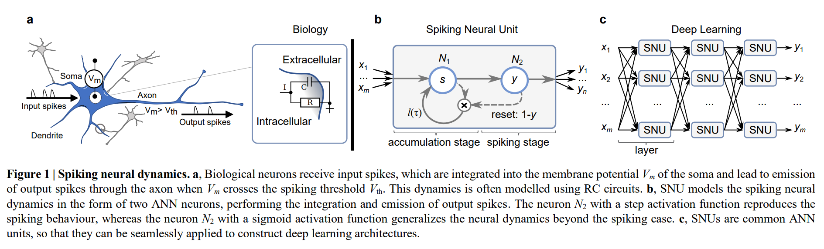
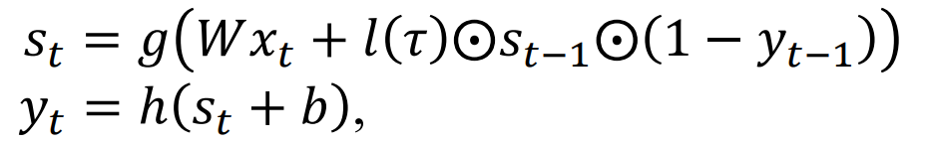

Slide 4
Backpropagation through time + Pseudo-derivative
Even though an SNU-based network is typically a feed-forward architecture, the state within the units is implemented using self-looping recurrent connections. For training such units, the ANN frameworks resort to algorithms such as backpropagation through time (BPTT).
Furthermore, for the computation of the gradients in the backward pass, backpropagation requires that all parts of the network are differentiable, which is the case for the sSNU variant, but not for the step function in the standard SNU. Nevertheless, in particular cases it is possible to train non-differentiable neural networks by providing a pseudo-derivative for the nondifferentiable functions.

Slide 5
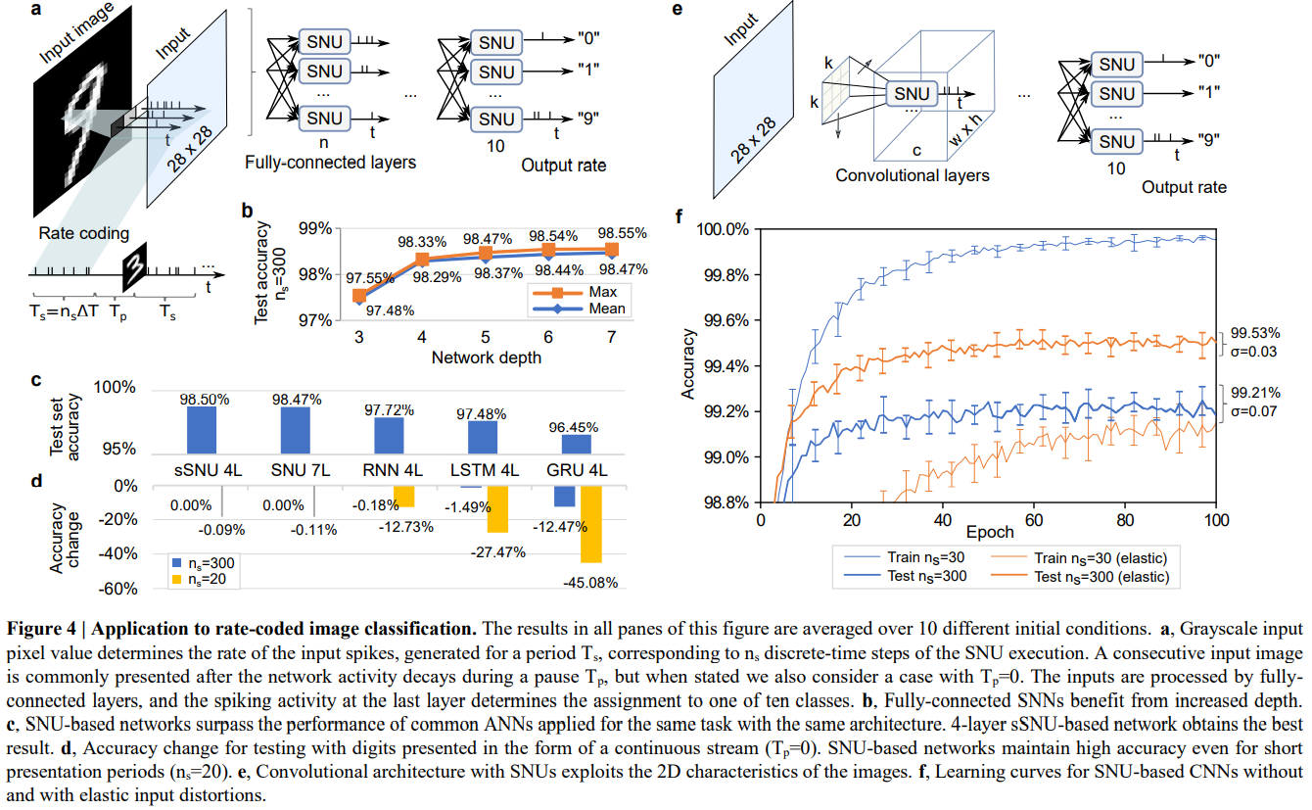
Handwritten digit recognition using MNIST dataset
Notes:
The inputs for the first task, which involves static data, were coded using the common SNN convention of rate-coding that enables the grayscale information of each pixel to be conveyed through a firing rate of the input spikes.

Slide 6
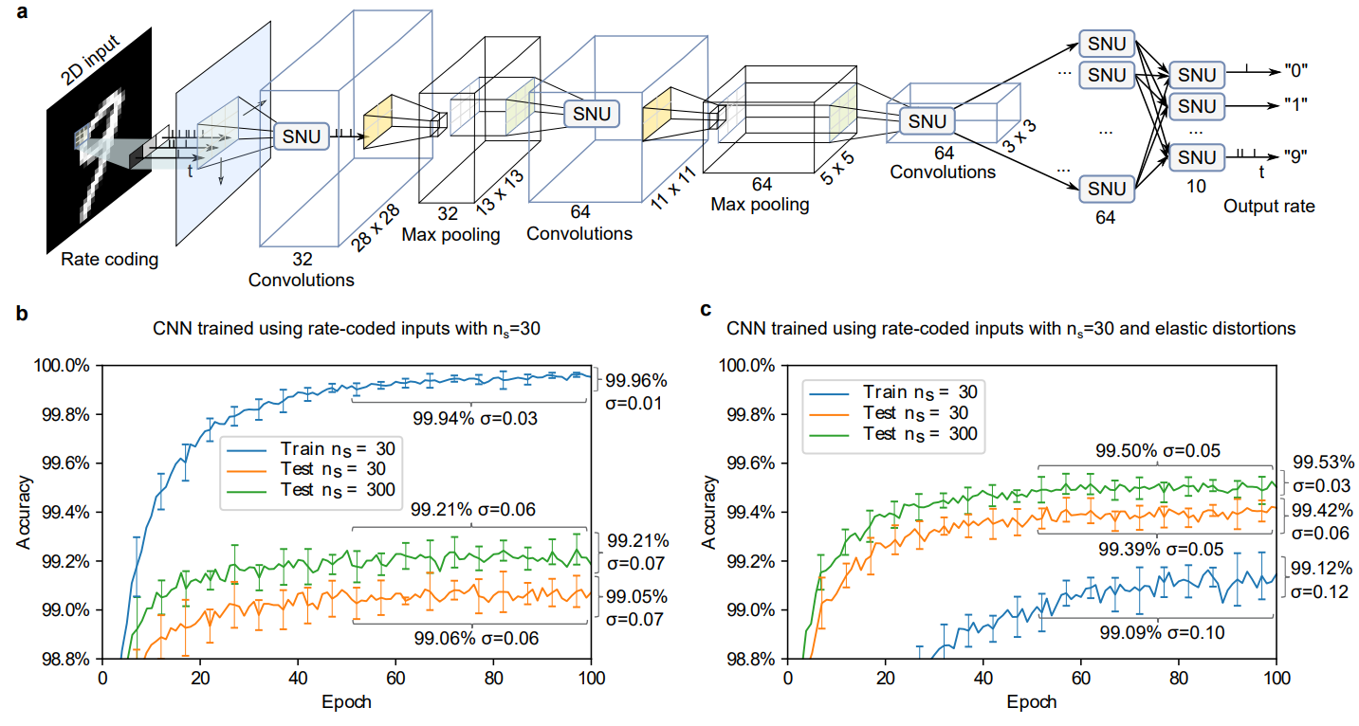
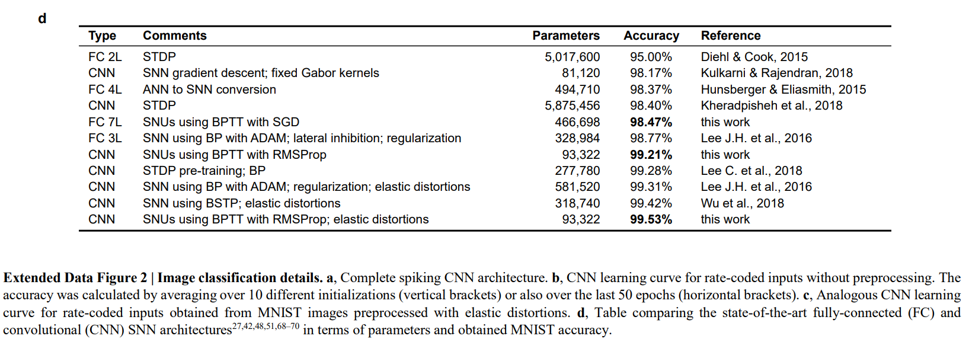

Slide 7
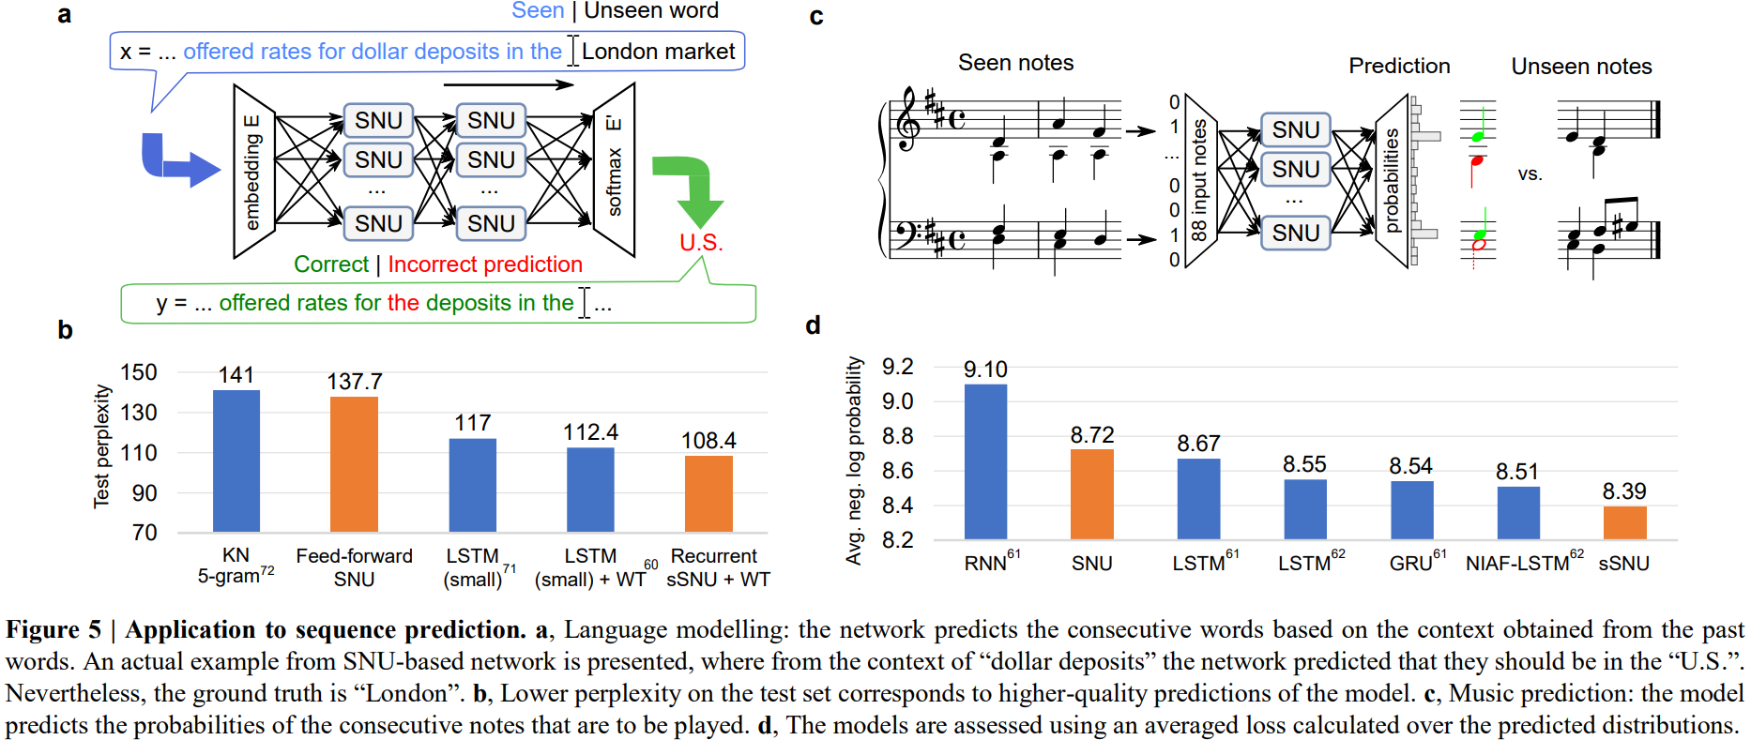
Language modelling using Penn Treebank (PTB) dataset56 and polyphonic music prediction using Johan Sebastian Bach’s chorales (JSB) dataset

Slide 8
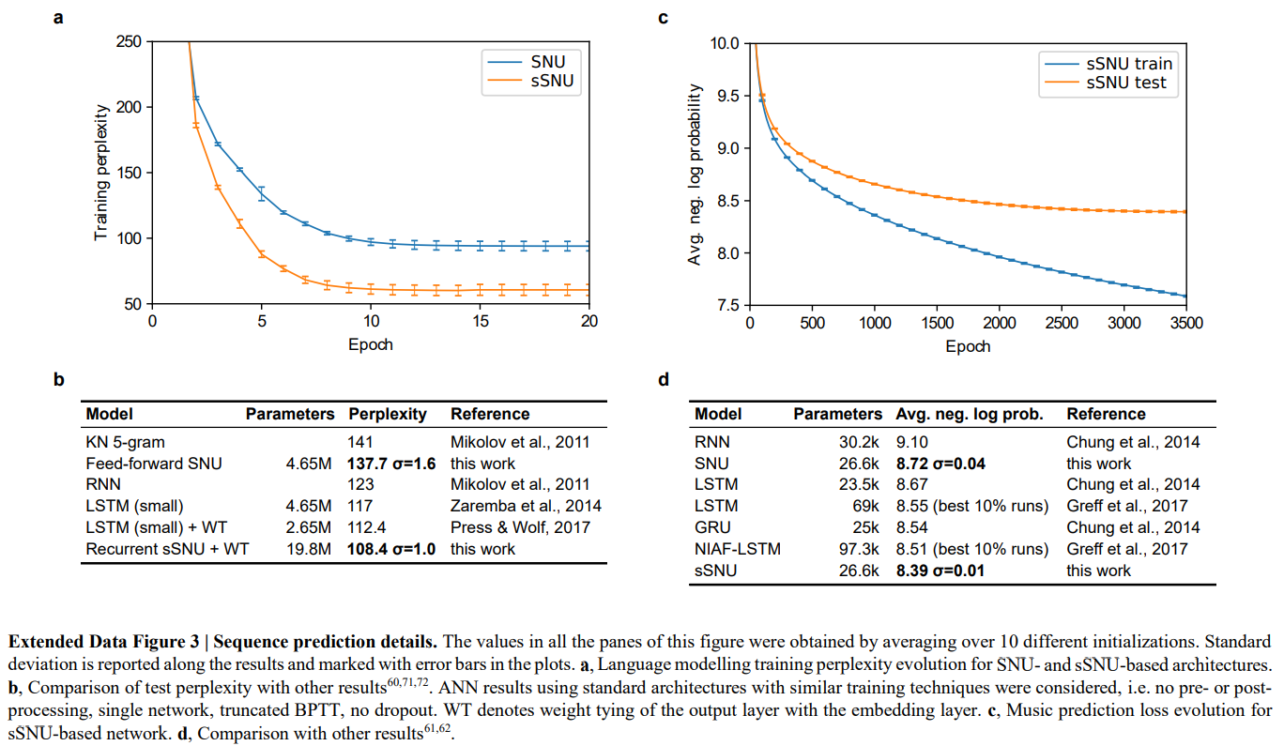

Slide 9
Experimental demonstration in neuromorphic hardware
The neuromorphic hardware concept consists of several crossbar memory arrays that map the synaptic weights to the conductances of the phase-change-memory (PCM) cells.
avoiding to move the data from the memory to the computing units
The memory cells perform the weighted input accumulation in-place based on their physical properties and the inherent capabilities of the crossbar structure.
The conductance of a PCM device depends on the relative configuration of the amorphous and crystalline phases.

Slide 10
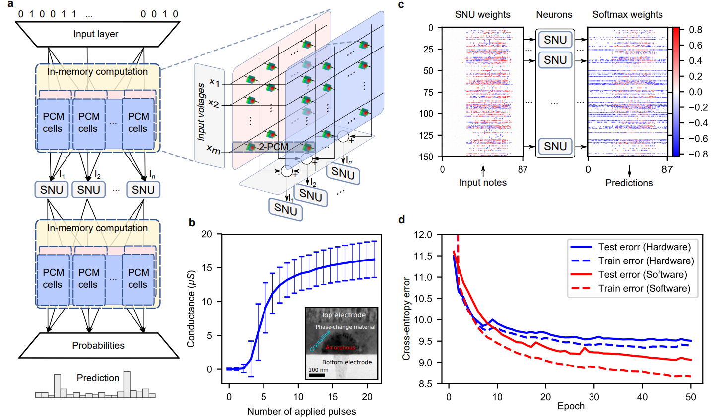

Slide 11
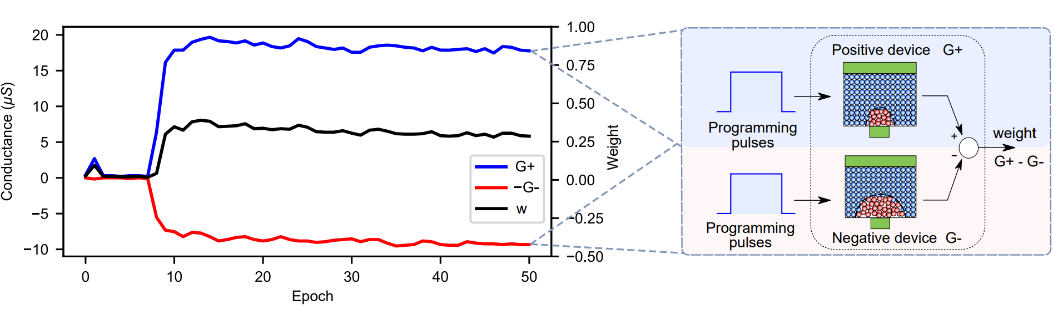
Adjust the device conductances through programming pulses
The synaptic inputs from the presynaptic neurons are converted to read voltage pulses sent to the PCM devices in the rows of the array.
Weight increase is performed through crystallization of the device with programming pulses.
The conductance decrease requires the amorphous phase to be recreated through the melting process with higher energy pulses, typically referred to as reset pulses.

Slide 12
THANKS

